Slide 1
Slides
Study design
Dacomitinib and Osimertinib SA cell viability data
PC9R NRAS and PC9 (historical, 3d cell viability assay)
PC9, RPC9-CL6, PC9 NRAS (HDB, 7d cell viability assay)
DOR studies in
Parental PC9 (complete)
All combos>Daco>Osi>DMSO
Daco resistance clone RPC9-CL6 (complete)
3D+21O>1.5D+10O ≅ 4.4D+10O>3D+5O>1.5+5O>1.5D+5O≅10O>DMSO
3rd gen EGFR TKI resistance pool PC9R NRAS (complete)
All growup quickly; Rx only slightly better
Mixed PC9:RPC9-CL6 (100:1) (on-going)
Mixed PC9:RPC9-CL6 (10:1) (on-going)

Slide 2
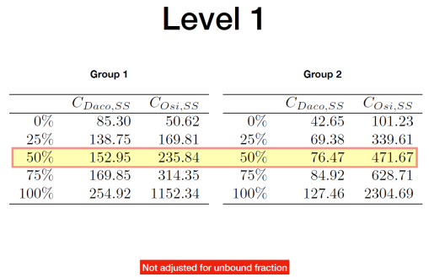
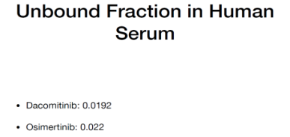
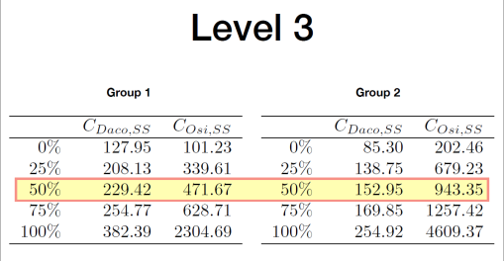
Daco and Osi in EGFRmut NSCLC
DOR studies in PC9 EGFR^{del} , PC9-CL6EGFR^{del+T790M}, and PC9R NRAS at HDB
Study plan
1L model PC9; 2L model RPC9-CL6 (clone); EGFRi resistance model PC9R NRAS (pool)
Mixed models: PC9/RPC9-CL6 (100:1); PC9/RPC9-CL6 (10:1)
Assay
Time to reach a pre-designated cell number that reflects restored growth rate (similar to no drug) in the presence of drug
Day -1: Seed cells at density of estimated cell confluency as ~40% on day 0 (document number of cell seeding))
Day 0: Take a photo to record the actually cell confluency and start drug treatment
Please note that 1) the priority is to start drug treatment at day 0, not 40% confluency as long as the cells seeding is at 10-50% range; 2) Start from cell seeding if the cell confluency is <10% or >50% on day 0
Feed cells with fresh medium and drug every week and observe cell growth by microscope daily for confluency
Trypsin and count when cells reaching ~75% confluency at each condition and reseed 1/6 of the total cells with fresh medium and drug
Repeat step 3-4 until cells reach 5 doubling time (32x cells of the initial seeding)
Observe cells by microscope daily and capture emerging colonies (if present) by photo
Per each model, the different arms for DOR (free drug conc in nM) with n=3/arm :
Vehicle
Daco SA (in vitro equiv of 45mg daco QD, 4.40 nM)
Osimertinib SA (in vitro equiv of 80mg osi QD, 10.38 nM)
Level -1: 1.47 nM Daco+5.19 nM Osimertinib
Level 1, group 1: 2.94 nM Daco+5.19 nM Osimertinib
Level 1, group 2: 1.47 nM Daco+10.38 nM Osimertinib
Level 3, group 1: 4.40 nM Daco+10.38 nM Osimertinib
Level 3, group 2: 2.94 nM Daco+20.75 nM Osimertinib

Slide 3
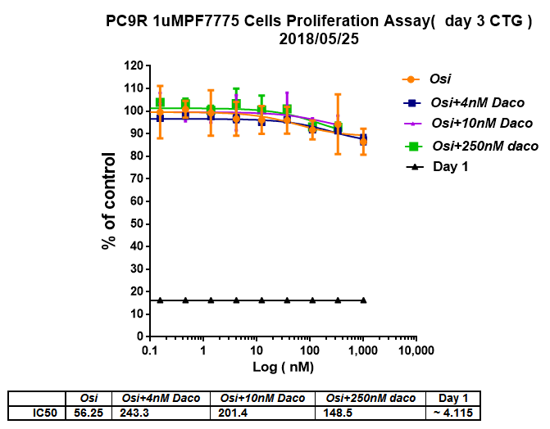
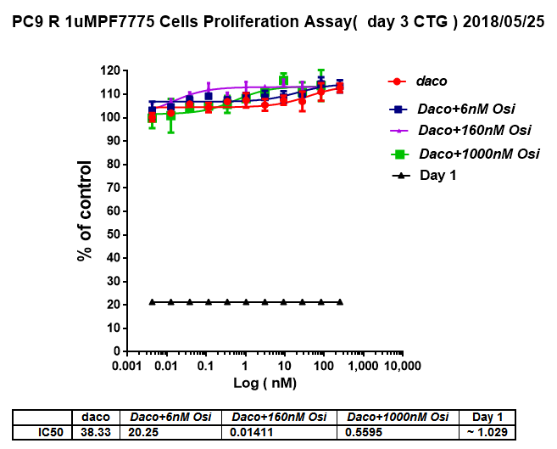
Historical IC₅₀ (Pfizer, shared with DFCI)
Day 0 baseline
Day 0 baseline
PF804=Dacomitinib
PF9696=Osimertinib
PF7775=3rd gen EGFR TKI used to select PC9R NRAS
PC9R=PC9R NRAS=PC9R 1uM PF7775
PC9-DRH (pool):70% Del/T790M and 30% Del; insensitive to Daco
RPC9-CL6 (clone): 90% Del and 10% Del/T790M; sensitive to Daco and Osimertinib

Slide 4
Cell viability IC₅₀ (HDB)
PC9R=PC9R NRAS=PC9R 1uM PF7775
PC9-DRH (pool):70% Del/T790M and 30% Del; insensitive to Daco
RPC9-CL6 (clone): 90% Del and 10% Del/T790M; sensitive to Daco and Osimertinib
Same data as above, re-ploted

Slide 5
2.94 nM Daco+20.75 nM Osimertinib
1.47 nM Daco+5.19 nM Osimertinib
Vehicle
(DMSO)
Osimertinib 10.38 nM
Daco 4.40 nM
2.94 nM Daco+5.19 nM Osimertinib
4.40 nM Daco+10.38 nM Osimertinib
1.47 nM Daco+10.38 nM Osimertinib
Steady growth

Slide 6
1.47 nM Daco+5.19 nM Osim
1.47 nM Daco+
10.38 nM Osim
Vehicle(DMSO)
Osimertinib 10.38 nM
2.94 nM Daco
+5.19 nM Osim
4.4 nM Daco+
10.38 nM Osim
Daco 2nM
Daco 4.4nM
2.94 nM Daco+
20.75 nM Osim
Steady growth

Slide 7
Steady growth

Slide 8
Daco 4.4nM
Osimertinib 10.38nM
Vehicle(DMSO)
1.47nM Daco+
5.19nM Osimertinib
2.94nM Daco+
5.19nM Osimertinib
#3
#1
#2
1.47nM Daco+10.38nM Osimertinib
4.40nM Daco+10.38nM Osimertinib

Slide 9
1.47nM Daco+5.19nM Osimertinib
Vehicle(DMSO)
Osimertinib 10.38 nM
2.94nM Daco+
5.19nM Osimertinib
Daco 4.4nM
1.47nM Daco+
10.38nM Osimertinib
4.40nM Daco+10.38nM Osimertinib
2.94nM Daco+20.75nM Osimertinib

